Slide 1
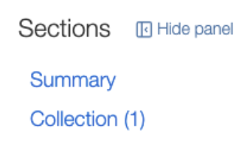

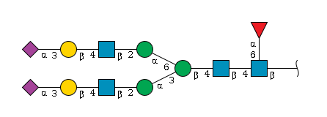
G17689DH
ID: G17689DH
Description: N-linked Complex/core-fucosylated glycan or NA
Organism: Homo sapiens, Mus musculus, Rattus norvegicus
Glycan details/information
GlyTouCan Acc: G17689DH
PubChem CID: 25098607 | [ID not found]
Monoisotopic Mass: 2,368.84 Da
Composition: Hex5 HexNAc4 dHex1 NeuAc2
Motifs: Type 2 LN (GGM.000001), 3-Sialyl-LN (type 2) (GGM.000034) |[Motif not found]
Organism: Homo sapiens, Mus musculus, Rattus norvegicus
More information for glycan G17689DH is available on GlyGen

Slide 2

Protein
: P14210
ID: P14210
Name: Hepatocyte growth factor
Organism: Homo sapiens
GlycoProtein details/information
UniProtKB Ac: P14210
RefSeq ID: NP_000592 | [ID not found]
RefSeq Name: hepatocyte growth factor isoform 1 preproprotein | [Name not found]
Gene Name: HGF | [Gene name not found]
Gene Location: Chromosome: 7 (81,770,438 - 81,699,008) | [Gene location not found ]
Ensembl Gene ID: ENSG00000019991 | [Gene ID not found]
Disease: autosomal recessive nonsyndromic deafness 39 (DOID:0110497) | [Disease not found]
Glycosylation Summary: 5 site(s) total, 55 N-linked annotation(s) at 4 site(s), 3 O-linked annotation(s) at 1 site(s) | [No glycosylation reported]
More information on protein P14210 is available on GlyGen

